Slide 1
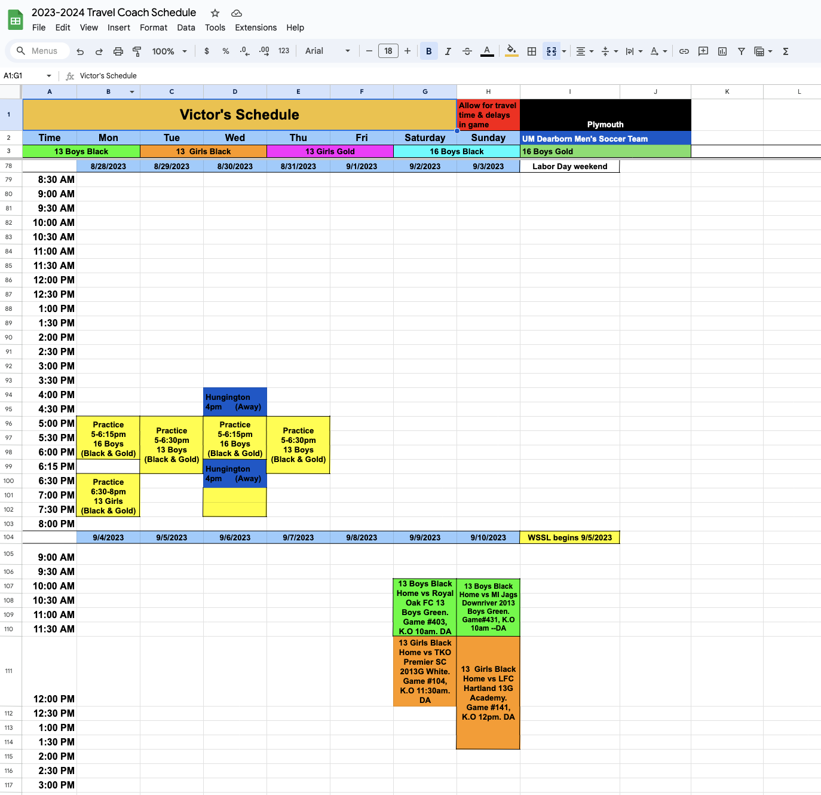
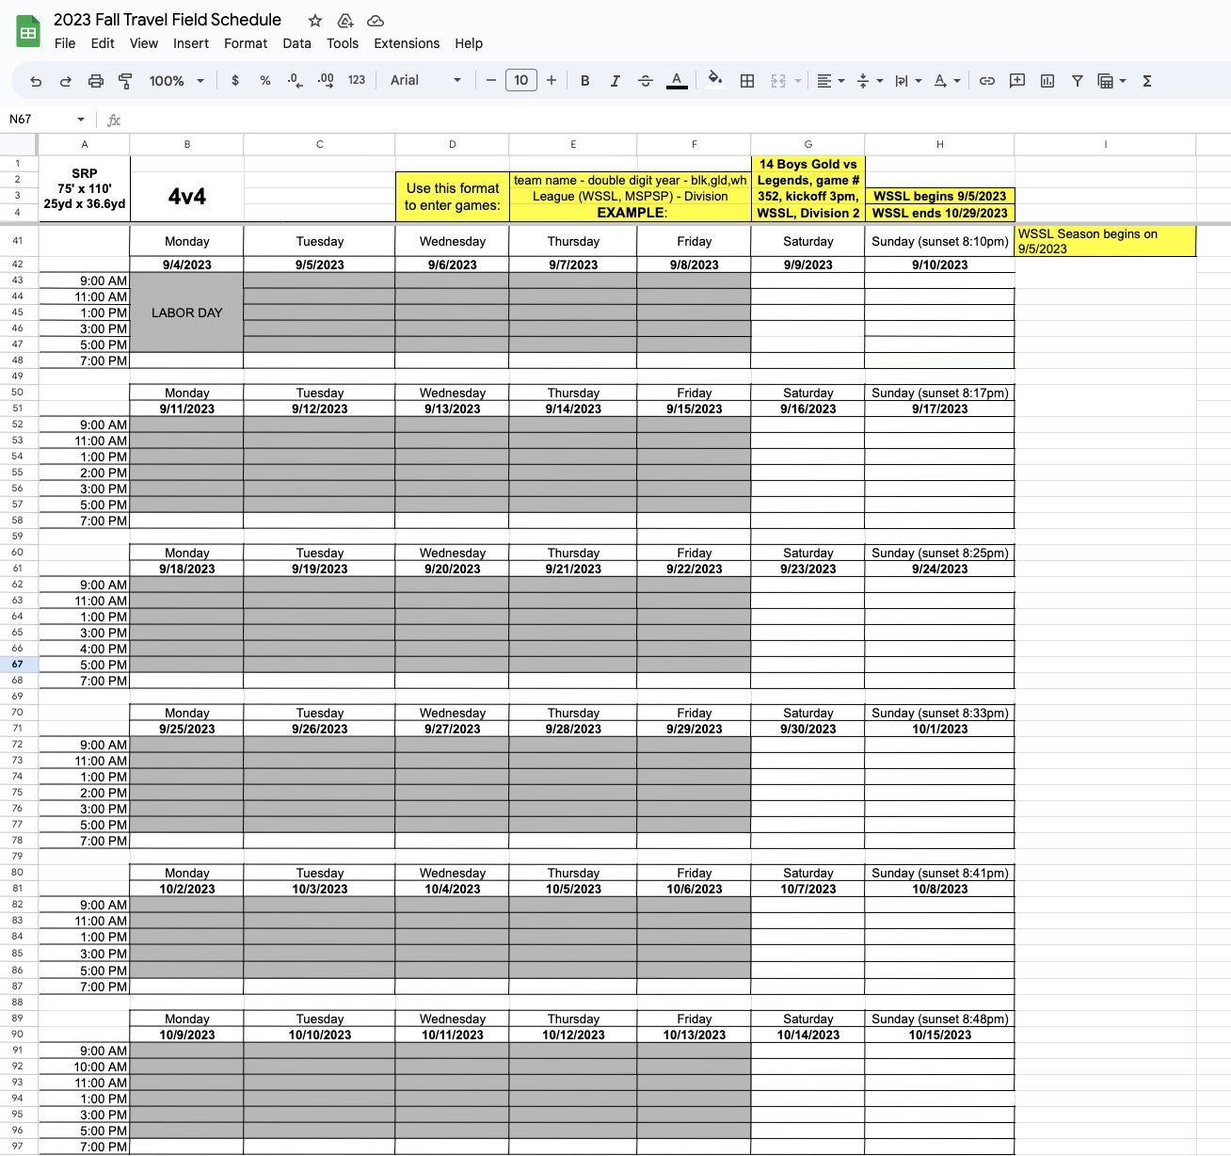

Slide 2
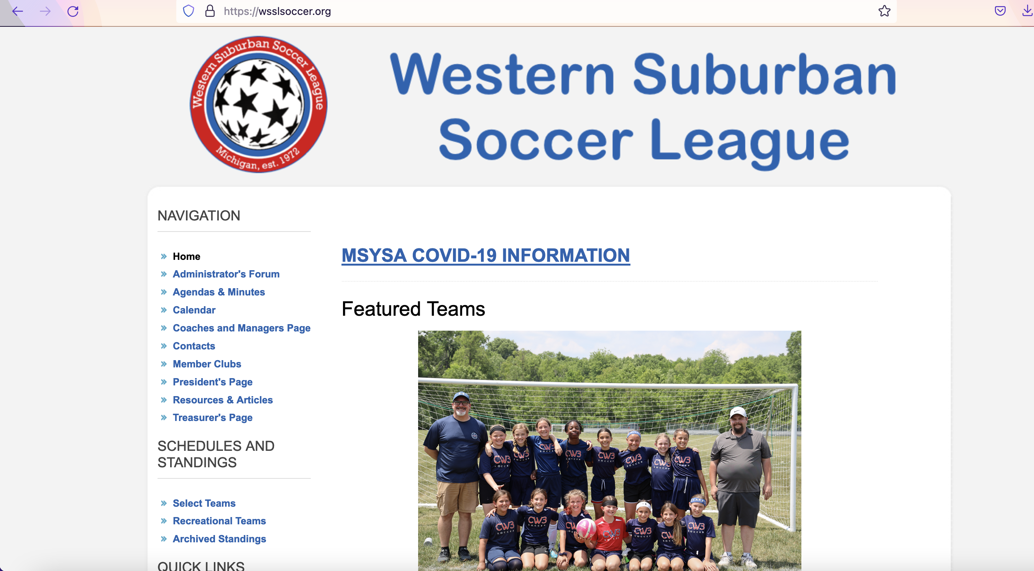

Slide 3
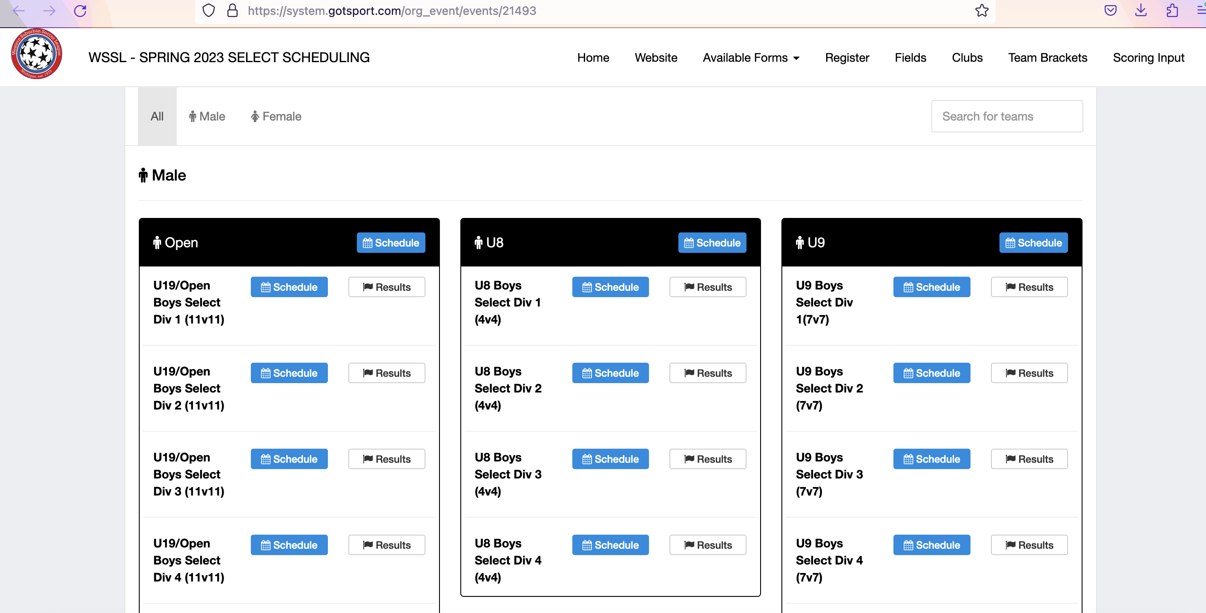

Slide 4
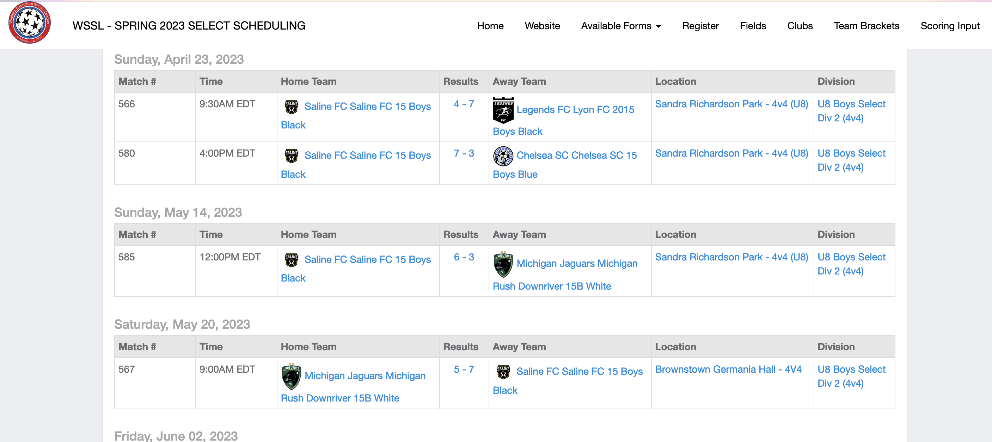
Home team listed on the left, away team on the right.

Slide 5
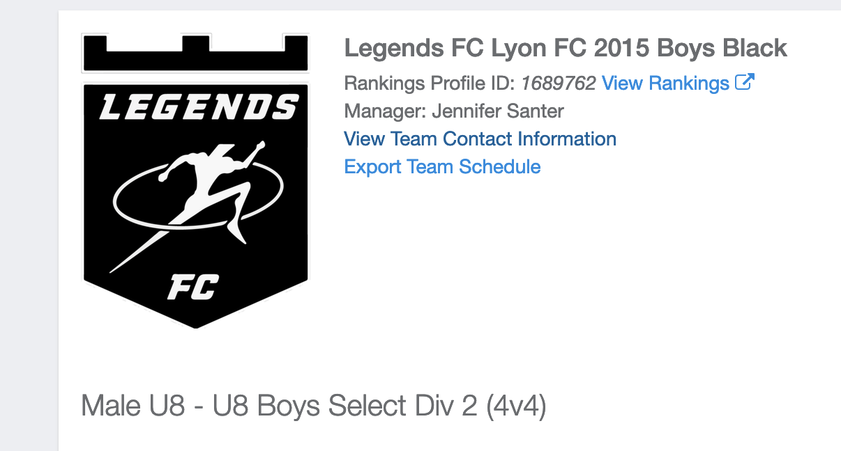
First thing I do is list who I am playing at home with every teams email addresses. Then list who I am playing away with their email addresses. To find each teams information, click on the team:

Slide 6
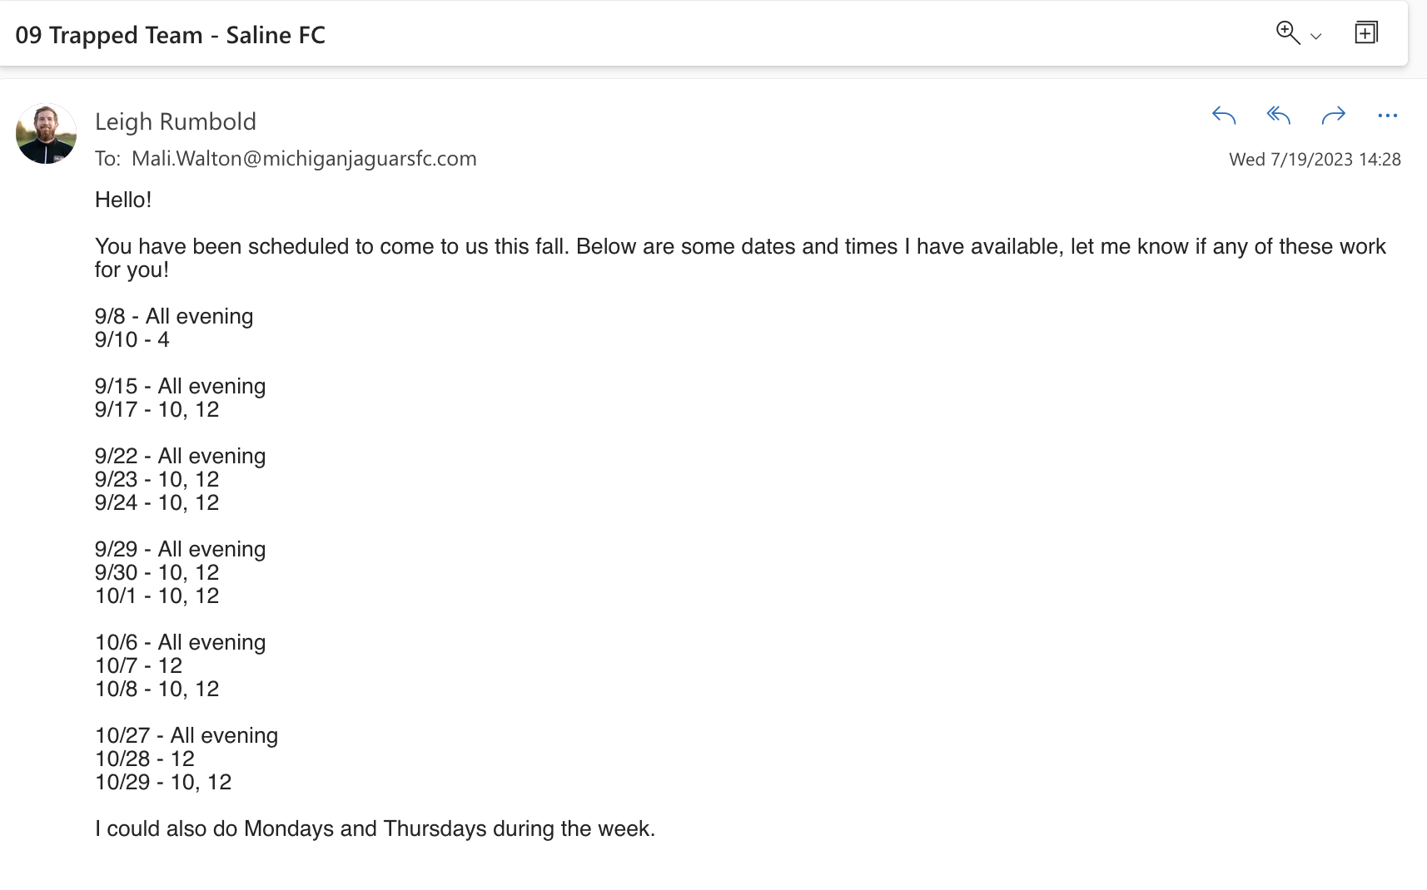
I then email all of the teams I am playing at home with my coaches availability and the times that the fields are available. Some team managers prefer to email/text/call each team manager or coach separately, I prefer to email:

Slide 7
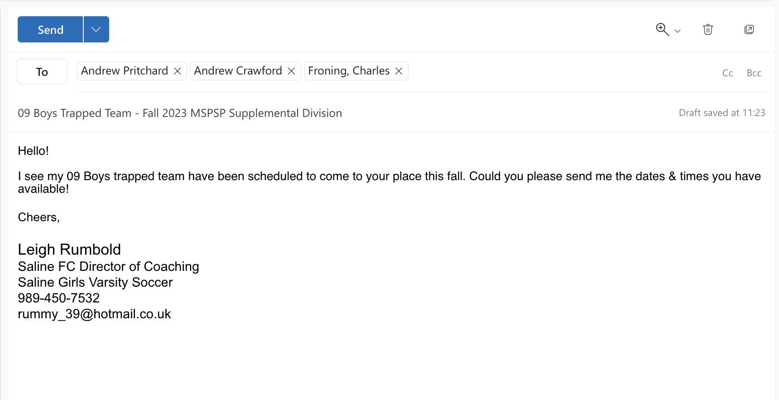
I then send a slightly different email to the teams that I am playing away, requesting times and dates that they have available and try to work it into the schedule:

Slide 8
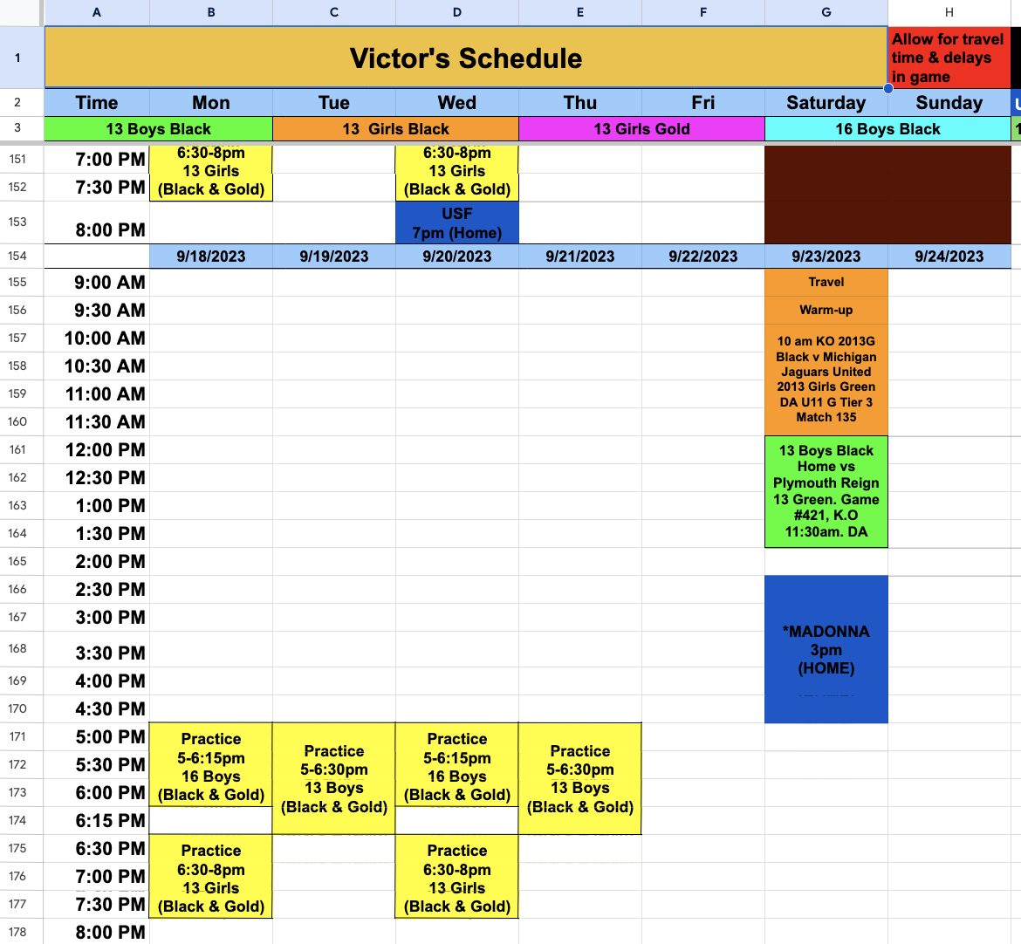
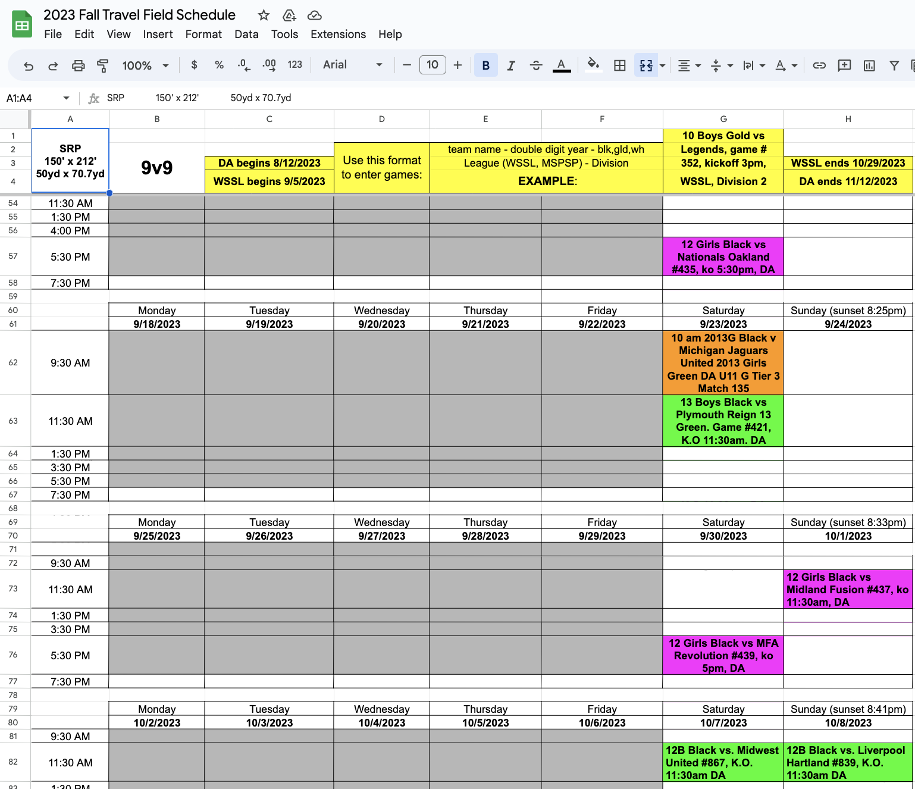
When a date and time has been agreed by both teams, please add the game into the field matrix and the coaches schedule documents:

Slide 9
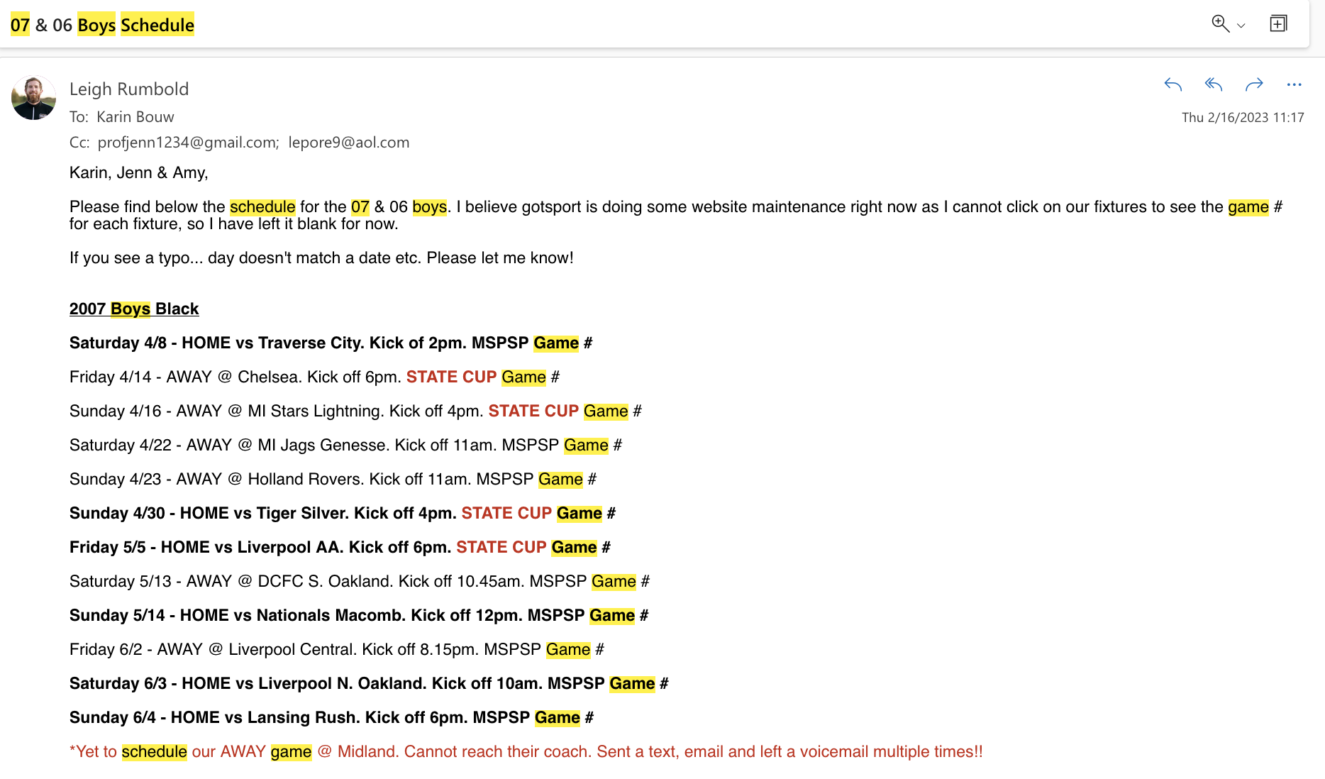
Once all the games have been scheduled, please send the full list to Chrissy in an email. Here is an example of my 07 boys schedule last spring season:

